Slide 1
Sequential Search with Offer Freezing: Theory and Experimental Evidence
Emanuel Marcu and Charles Noussair
Tilburg University and University of Arizona
November 2022
Presentation prepared for the Tokyo University seminar series

Slide 2
Options to Freeze Prices
Many airlines have begun offering an opportunity for travelers to freeze ticket prices before committing to a purchase.
  United Airlines offers an option, called Farelock, to freeze a price for one week for a fee of between 5 - 10 US dollars.
  KLM offers similar possibilities to lock a fare in for 14 days for 10 – 15 Euro.
The mortgage and hotel markets have similar features. Locking in interest rates and free cancelation of reservations.
The effect of this option to freeze has not yet been analysed by economists.
The focus here is on the economics of price freeze options (not on modeling the airline industry in particular).

Slide 3
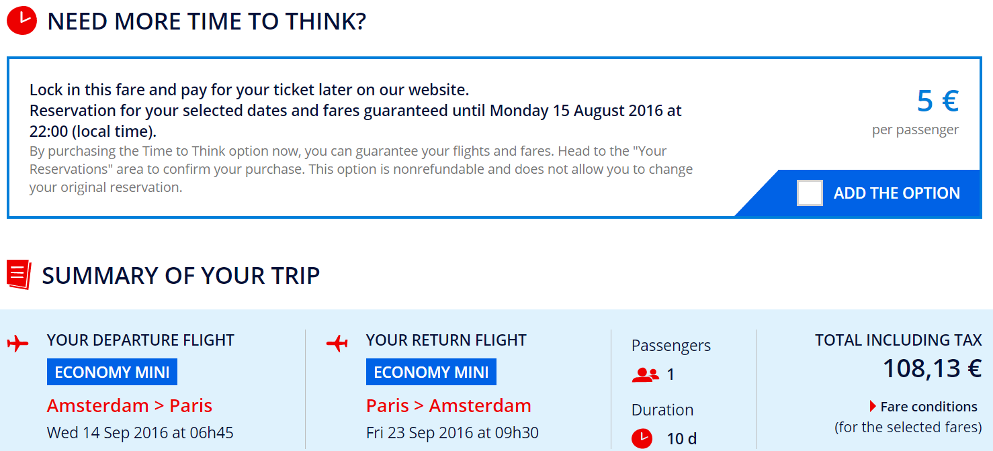
Air France

Slide 4
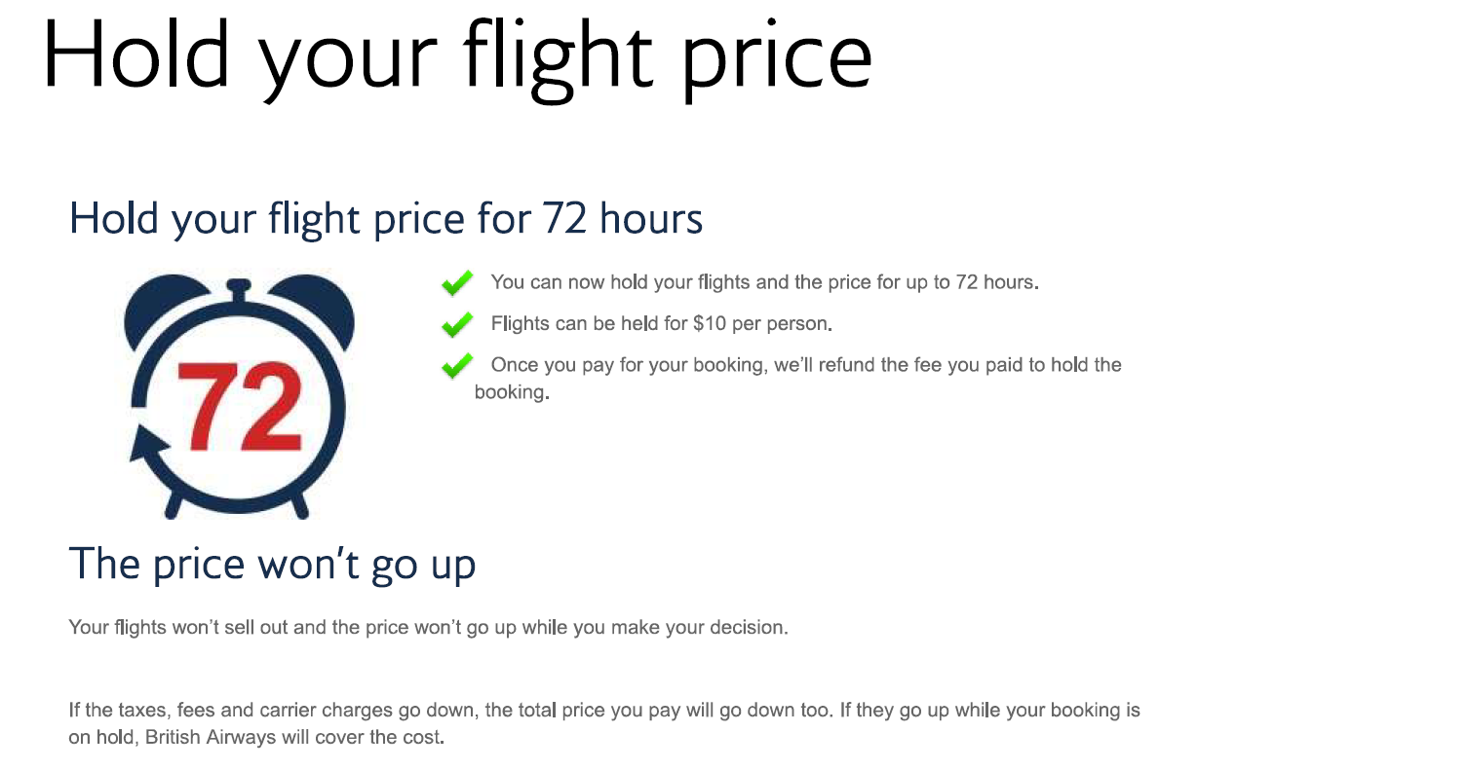
British Airways

Slide 5
What we do in this paper
We construct a theoretical model to evaluate the consequences of a price freezing option.
Model assumes a sequential search structure and a finite horizon.
  Airline ticket purchases are a good example of sequential search over a finite horizon.
We then conduct an experiment to evaluate the predictions of the model.
  The hypotheses for the experiment emerge from the model.
Two environments are considered, No Recall and Imperfect Recall.
  I will focus on the case of No Recall of previous offers in this talk.

Slide 6
What is the point of doing a laboratory experiment here?
We would like to know how difficult it is for individuals to make optimal decisions in this setting.
Experiments have shown that in many settings, individuals are able to perform close to optimally.
In other settings, people are overcome with decision biases.
We would like to know what kind of situation this is.
How costly should we expect any deviations from the optimum to be?

Slide 7
THEORY

Slide 8
Theoretical model with No Freezing
Uses a sequential search model structure (McCall, 1970, Landsberger and Peled, 1977; Karni and Schwartz, 1977)
A potential buyer of a good has a fixed valuation v for the item.
There are T stages.
In each stage, buyer receives one price offer p_{t}, less than her value.
  Price offers p_{t} are i.i.d draws from a distribution F(p).
At each stage t, she can choose to (a) accept or (b) reject the offer.
  If she accepts an offer p_{t}, she receives payoff v – p_{t}.
There is a cost of c of drawing an additional offer in the next stage.
Buyer is risk neutral.
There is no recall of prior offers.

Slide 9
The optimal decision rule: a reservation price rule
If no freeze option is available, the optimal strategy is a reservation price rule (RR).
Compare expected payoff from acceptance and rejection at each stage.
  Accept all offers below some threshold p’(t), reject all of those above
  p’(t) is the point at which a player is indifferent between accepting and rejecting.
  Threshold increasing in t. You get less picky over time.
  In the last stage, accept any offer.

Slide 10
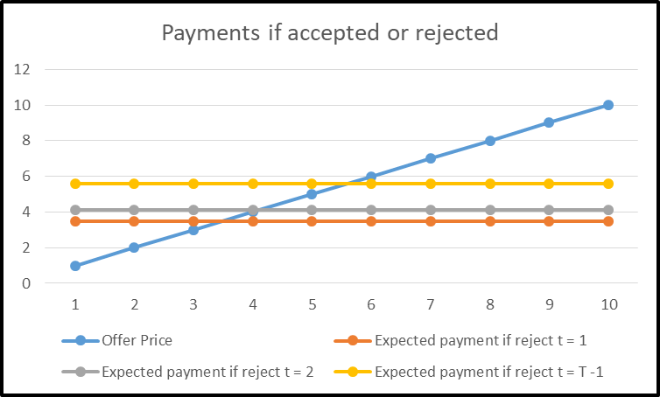
Payment
Consumer becomes less picky over time and threshold increases
p’(1)
p’(T-1)
Price
Price Offered

Slide 11
Adding a freeze option
Suppose we add a third option, to freeze the offer received in any stage.
  An offer that is frozen can be recalled and accepted in any later stage until T.
  Only one offer can be frozen.
  Offers cannot be unfrozen.
  There is a fee of f to freeze an offer
Freezing an offer is, in effect, the purchase of an outside option

Slide 12

First, consider an exogenous outside option
To build up the model, we first consider the case of an outside option that is exogenous
At each stage t, need to compare
  (a) payment if accepting current offer, p_{t}
  (b) payment if taking outside option, k and
  (c) expected payment from rejection and continuation .
is the expected payment the searcher makes. Choice at time t is made to minimize this.

Slide 13
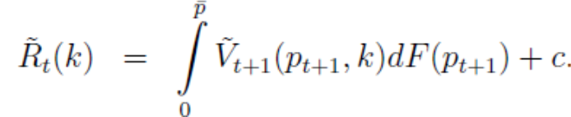
A couple of definitions:
The expected rejection payment: Let
be the expected amount paid if offer of stage t is rejected when there is an outside option.
To get the next stage’s offer, agent must pay cost c.

Slide 14
p*
Let p* be the price that makes an individual indifferent between
  (i) accepting the current best offer, min{p_{t}, k} and
  (ii) waiting exactly one more stage and accepting the best offer available in the next stage min{p_{t+1}, k}.
  It is the price that makes you indifferent between accepting or rejecting in period T – 1.

Slide 15
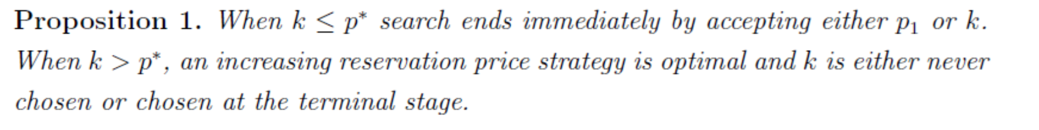
Acceptance of the outside option
If the outside option k ≤ p*, one would never reject at T - 1. You either accept current offer or outside option. Because you would never reject at T – 1, at T – 2 it is as if there is only one stage remaining. So you never reject at T – 2. This unravels to stage 1. If you never reject at t = 1, you either accept current offer or take the outside option at t = 1.
If the outside option k > p*, you always want to either accept the current offer or reject it and continue searching for at least one more stage. The only time that you could choose the outside option is in stage T and only if it is lower than the current offer of that stage.

Slide 16
Optimal strategy under endogenous freezing
Now suppose that you can pay a fee of f to freeze the current offer p^{t}
The optimal strategy is a reservation/double reservation price rule (RR-DRR).
  DRR strategy: Accept offers below a_{t}, freeze those between a_{t} and b_{t}, and reject those above b_{t}, with a_{t} ≤ b_{t}.
  If horizon is long enough, in early stages a_{t} = b_{t} (RR). Either accept or reject.
  In late stages a_{t} < b_{t} (DRR). Accepting, freezing, or rejecting are all possible.

Slide 17
Example of a DRR (Double Reservation Price Rule)
In later stages, as the rejection payment increases, it becomes optimal to freeze some offers.
Offers below a_{t} are accepted, those between a_{t} and b_{t} are frozen, and those above b_{t} are rejected.
If accept p_{t}
Payment
If freeze p_{t}
If reject
Offer at stage t

Slide 18
Formal statement of optimal policy
Single-threshold strategy always followed by double threshold strategy.
There is always some positive probability of freezing by stage T – 1.
If the horizon is sufficiently long, there will be stages at the outset where it is optimal not to freeze any offer.
Freezing more likely over time until stage T – 1.
Both thresholds a_{t} and b_{t} increase over time. Get less picky over time with both acceptances and freezing.
Frozen offers, if accepted, are only accepted in period T.

Slide 19
THE EXPERIMENT

Slide 20
Previous work
Kahan, Rapoport and Lyle (1967): Varied distributions of offers and observed that this did not have a strong effect on optimality of decisions. Subjects tested in groups searched longer.
Rapoport and Tversky (1970): Decisions close to optimal with some early stopping.
Schotter and Braunstein (1981): Found behavior close to optimal in indefinite horizon, differences between risk averse and risk neutral incentives.
Cox and Oaxaca (1989): Finite horizon, behavior close to optimal.
Cox and Oaxaca (1992): Reservation wage behavior consistent with risk aversion.
Gong and Ramachandran (2007): Shape of payoff function is important.
Weng et al. (2009): Claim that undersearching is a result of regret and is affected by feedback.
Zwick et al., (2003): find undersearching in a secretary problem.

Slide 21
The experiment
Subjects were in the role of sellers (as in a labor market setting) rather than buyers.
Each round consisted of T stages.
Conducted in terms of an experimental currency (70 ECU = $1)
Offer were drawn from U[0, 1000] in each stage
Search cost c = 10.
180 offer sequences (rounds) in each session

Slide 22
Treatments: Varied time horizon and freeze costs
T ε {4, 10}, Short (T4) or Long (T10) Horizon
f ε {ꝏ, 10, 40}, No Freezing allowed (NF), Low Freeze Fee (LF), High Freeze Fee (HF)
T was varied between subject, f was varied within subject
60 rounds under each of Low Fee (LF), High Fee(HF) and No Freezing (NF), order counterbalanced.

Slide 23
Implementation
177 subjects
Conducted at the Economic Science Laboratory at the University of Arizona
Used z-tree (Fischbacher, 2007)
Two price lists to measure risk aversion administered before main task (simple price list, and a Holt-Laury (2002) task)
1 of 182 total tasks counted toward earnings
Forced two-minute breaks after 60 and 120 sequences
Required to spend at least 60 minutes on the task.
Perturbed, but nearly identical, sequences used in each of the three 60-period blocks

Slide 24
Display as seen by subjects

Slide 25
Optimal decisions in treatment with T = 10 and no freezing
Black = Accept
White = Reject
High offers are accepted with the reservation price declining over time.
Predictions for T = 4 are those from period T – 3 on.
In period T, accept all offers.
Offer
Time

Slide 26
Optimal decisions in treatment with T = 10 and no freezing
Black = Accept
White = Reject
High offers are accepted with the reservation price declining over time.
Predictions for T = 4 are those from period T – 3 on.
In period T, accept all offers.
Offer
Time

Slide 27
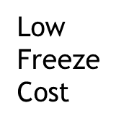
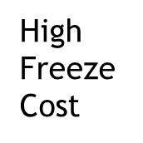
Optimal decisions: T = 10, Freezing option available
Offer
Black = Accept
Gray = Freeze
White = Reject
Time
Freezing is increasingly likely over time, and when the fee is lower.
Acceptance is increasingly likely over time, and when the freezing fee is higher
Rejection less likely over time, and when fee is lower
Offer
Time

Slide 28
Predictions: Search length, Freezing Usage
Search length is increased by lower freeze costs, and longer horizon.
Freezing usage is increased by lower freeze costs, and a shorter horizon.
Earnings are increased by availability of freezing (if horizon is short), lower freeze costs and a longer horizon.

Slide 29
Hypotheses
H1: Search length is shorter when f is greater and T is smaller.
H2: Freezing is less frequent when f is greater and T is greater.
  The second part of the prediction is a stringent test of the model.
H3: Individuals employ the optimal RR-DRR strategy
These are all predictions of the model.

Slide 30
RESULTS

Slide 31
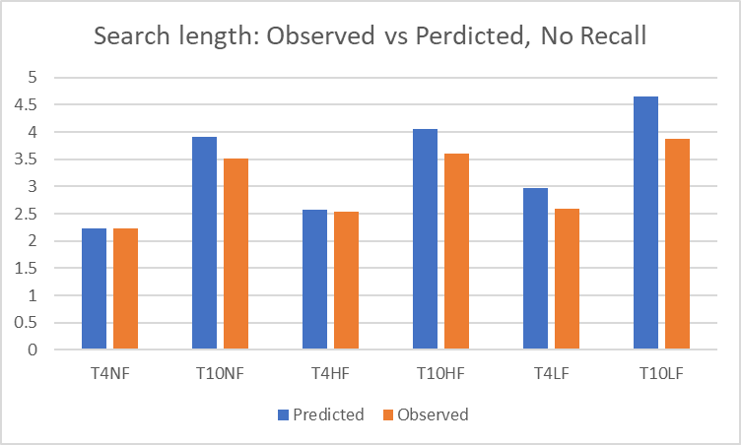
Results: Average search length, by treatment
Search length longer with:
- Possibility of freezing (H1 +)
- Lower Freeze Fee (H1 +)
- Longer Horizon (H1 +)
Search length shorter than predicted except for T4NF, T4HF

Slide 32
Freezing usage and acceptance of frozen offers
Freezing is more common when:
- Freezing is cheaper (H2 +)
- The horizon is short (H2 +)
Less freezing than predicted by model
Those frozen offers that are accepted tend to be accepted in the last stage in T4, but not T10.

Slide 33
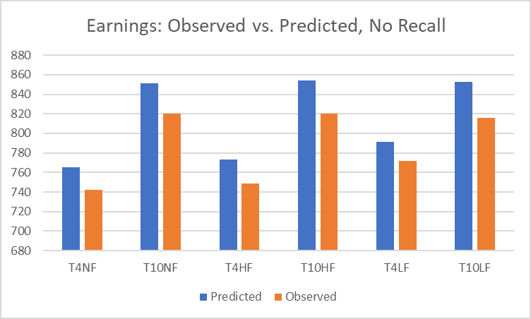
Earnings
Earnings are greater when freezing is available than in its absence when horizon is short.
Earnings are greater when freezing is cheaper when the horizon is short.
No effect of freeze cost when horizon is long.
Earnings are greater when the horizon is long than when it is short.
Earnings are quite close to the optimum

Slide 34
Do people use RR strategies? No Freezing treatments, stage 1 behavior
Strong differences between behavior above and below optimal threshold.
Modestly more acceptances than predicted under T = 10.
Fitted threshold = 666
Theoretical prediction = 675
Fitted threshold = 771,
Theoretical prediction = 806
Fitted function l{x;m,k) = [1 + exp(-k(x – m))]⁻¹ m = midpoint, k = curvature

Slide 35
Low Freeze Fee treatments, stage 1 behavior
Fitted acc threshold = 768, pred = 834
Fitted freeze threshold = 512, pred = 502
Fitted acc. threshold = 808, pred = 846
Fitted freeze threshold = 770, pred = 743
Fitted function l{x;m,k) = [1 + exp(-k(x – m))]⁻¹ m = midpoint, k = curvature
Acceptance behavior: observed threshold lower than predicted.
Freezing peaks in predicted range.

Slide 36
High Freeze Fee treatments: stage 1 behavior
Ac
Fitted acc. threshold = 745, pred = 765
Fitted freez. threshold = 591, pred = 602
Fitted acc threshold = 782, pred = 811
No freezing predicted
Fitted function l{x;m,k) = [1 + exp(-k(x – m))]⁻¹ m = midpoint, k = curvature
Some degree of undersearching. Acceptance threshold is modestly lower than predicted.
Estimated freezing threshold as predicted.
However, considerable failure to freeze when optimal.

Slide 37
Evaluation of Hypotheses
H1: Search length is shorter when f is greater and T is smaller. STRONGLY SUPPORTED
H2: Freezing is less frequent when f is greater and T is greater. STRONGLY SUPPORTED
H3: Individuals employ the optimal RR-DRR strategy MIXED SUPPORT

Slide 38
ALTERNATIVE EXPLANATIONS FOR UNDERSEARCHING
We evaluate four potential explanations that have been proposed to explain undersearching when freezing is not possible

Slide 39
Alternative explanations: Regret
1) Regret (Loomes and Sugden, 1989; Weng 2009)
Lowers value of accepting, freezing, and rejecting.
This predicts oversearching, so we do not consider it further.
Why? Individuals experience regret from accepting prices worse than those that they rejected previously, making them less willing to sell.

Slide 40
Alternative Explanations: Cognitive Acquisition Cost
2) Cognitive acquisition cost, Insufficient backward induction (Gabaix et al., 2006)
Three versions:
  a) Act as if you are in stage t+1 when really in stage t
  b) Act as if you are in stage t+2 when really in stage t
  c) Act as if you are in stage T – 1.
All of these specifications predict overfreezing, which we do not observe.

Slide 41
Alternative explanations: Sunk Cost Fallacy
3) Sunk Cost Fallacy (SCF) model (Kogut, 1990)
Use total cost instead of marginal cost in calculation of expected rejection payment
This can capture a situation in which individuals are eager to terminate long searches.
Predicts undersearching

Slide 42
Alternative Explanation: Risk Aversion
4) Risk aversion (Cox and Oaxaca, 1989)
Typical estimate for the CRRA functional form in experimental work is .3 (Holt and Laury, 2002; Harrison and Rutstrom (2008), Noussair et al. (2014)).
Also predicts undersearching.

Slide 43

Agreement of decision with Risk Neutral Optimal model and alternative models in instances with competing predictions.

Slide 44
CONCLUDING THOUGHTS

Slide 45
Summary of results: Search length
The length of search is increasing in the horizon length, and decreasing in the freezing fee.
  These effects are predicted by the model
Suggests that sellers introducing a freezing option will make customers search longer. Lower freezing fees will make them search even longer.
This is not good for efficiency since there is a cost (deadweight loss) associated with greater searching.

Slide 46
Summary of results: Use of the freezing option
The use of freezing decreases in the freezing fee and the horizon length
Most acceptances of frozen offers occur in the last period.
These effects are predicted by the model.
However, overall, there is less freezing than predicted
Suggests that uptake on sellers’ freezing options will be less than predicted
  Loss aversion?

Slide 47
Summary of Results: Payoffs/Earnings
Earnings are only slightly less than along the optimal path. Important because it reveals that this type of decision problem is not very difficult for people.
Earnings are greater when the horizon is longer
When the horizon is short, earnings are higher the lower the freezing fee.
Overall, consumers can be expected to make good decisions in a market with price freezing.

Slide 48
Summary of Results: Payoffs/Earnings
Earnings for the other party (airlines):
  Introduction of a freeze option lengthens search.
  It increases searching party’s earnings, despite the fact that they pay more in search cost.
This means that the other side of the market is worse off under a freeze option.
Airlines might find that they are worse off with the freeze option.
They might lose money on each individual customer, but make it up with market share.
They might have no choice. Freezing might be another margin which they might have to compete on.

Slide 49
THANK YOU

